Slide 1
Predicted Points
True Points

Slide 2

Procedures
Data collection
Data Exploration
Logistic regression
KNN
Naive Bayes
SVM
Decision Tree
Random Forest
Classification

Slide 3
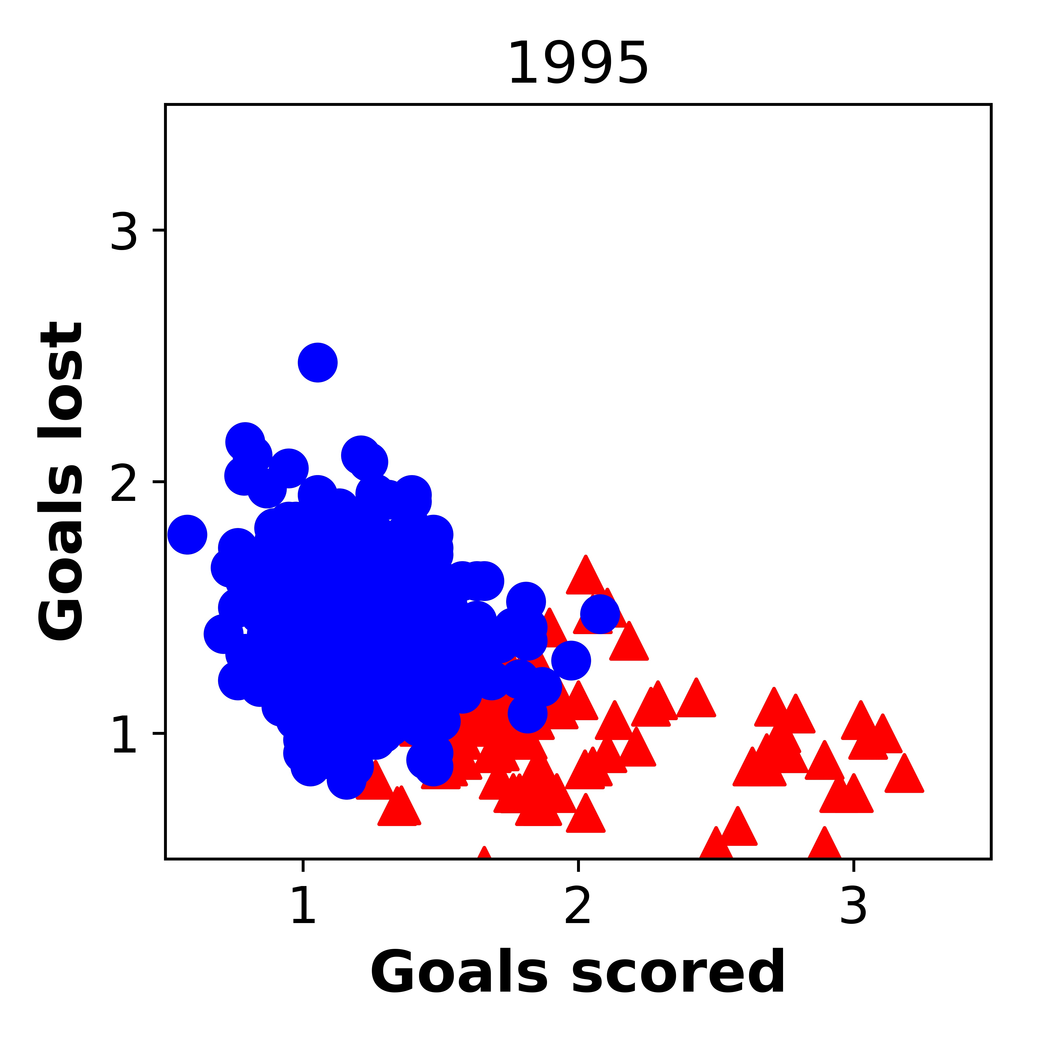
Non-Top4
Top4

Slide 4
> 0.8

Slide 5
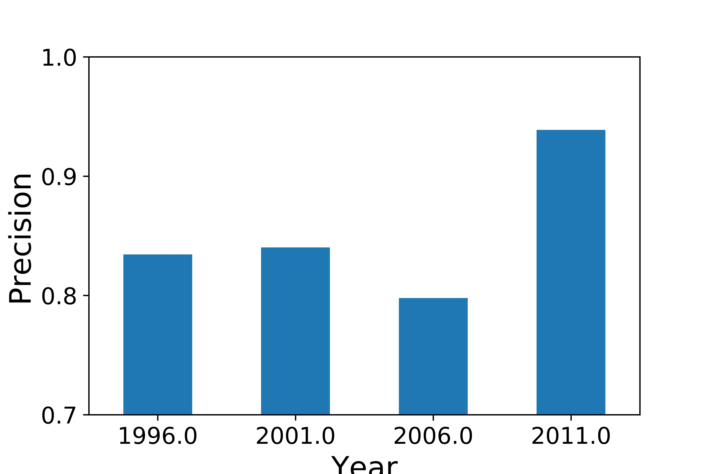

Precision
1996-2000 | 2001-2005 | 2006-2010 | 2011-2015

Slide 6
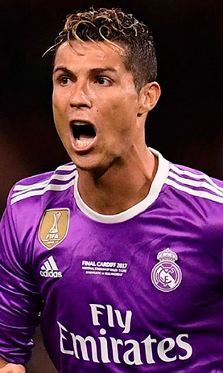
Rank
Lionel Messi
FC Barcelona
Cristiano Ronaldo
Real Madrid

Slide 7
Team
Messi
Lionel Messi
FC Barcelona

Slide 8
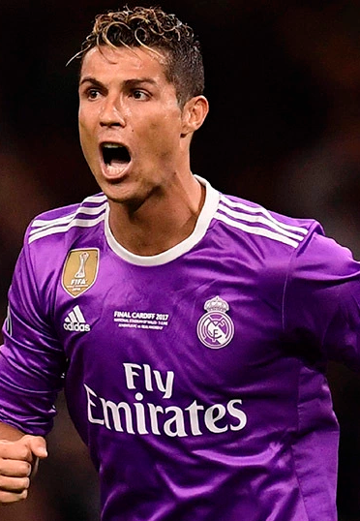
Team
Ronaldo
Cristiano Ronaldo
Real Madrid

Slide 9
Lionel Messi
FC Barcelona
Cristiano Ronaldo
Real Madrid

Slide 13
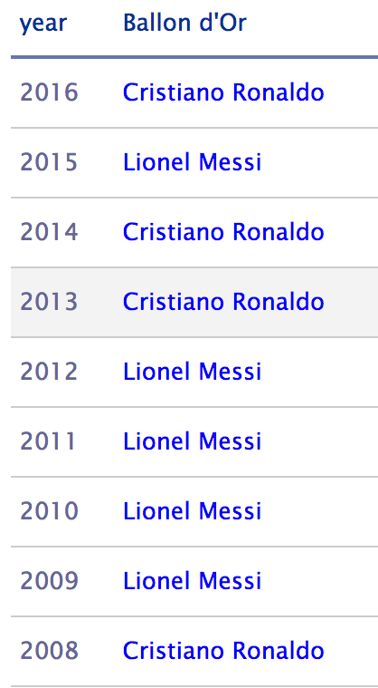
Dominance of these two players
Football Player's of the Year
2017 Cristiano Ronaldo
Source: http://www.topendsports.com/sport/soccer/list-player-of-the-year.htm
BBC sports news; on Oct 23rd, Monday
Notes:
The dominance of these two players can be seen in this table. These 2 players were the top 2 player in the past 10 years.

Slide 14
Tune the model to minimize overall error
KNN model
K = 11
Training error
Testing error
Notes:
Besides adding more features, I also tune the model to optimize the models. For example, for the case of KNN model, I optimized the K neighbor value to avoid under-fitting and over-fitting, and find the optimal results

Slide 15
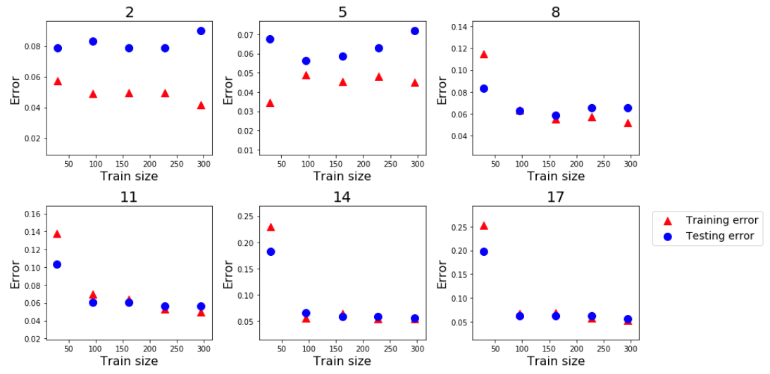
Tuning the KNN model
Optimal k is around 11

Slide 16
Simulated results

Slide 17
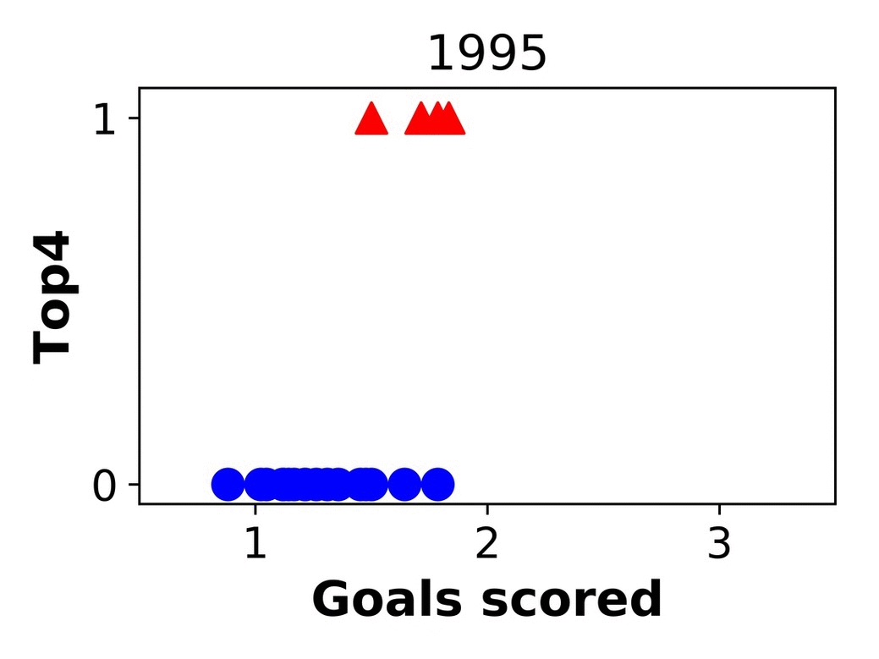
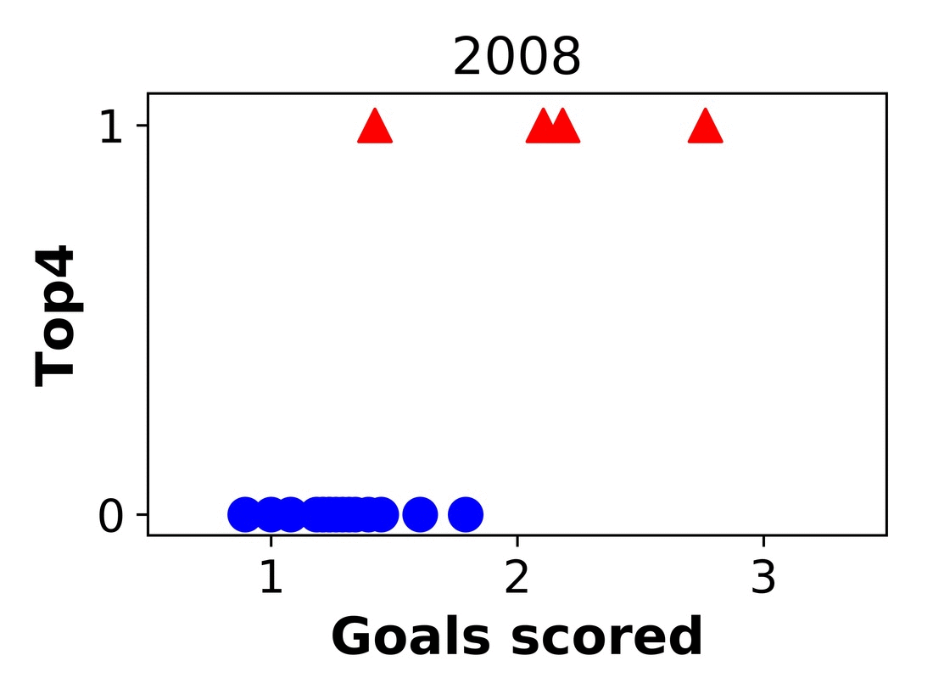
What happened in 2008?

Slide 18
To do
SQL
Further tuning the model?
SVM: Slack Variables
KNN: best K to use? (RandomizedSearchCV vs GridSearchCV)
Learning curve / ROC curve
Standardize the data
More data
results in other soccer leagues for comparison

Slide 19
Average value for Top4 teams
Goals scored
Goals lost
Notes:
If we look at the features overtime, we can see that, the average goals scored is increasing after the year of 2012

Slide 20
Dominance of these two players
Football Player's of the Year
Source: http://www.topendsports.com/sport/soccer/list-player-of-the-year.htm
BBC sports news; on Oct 23rd, Monday
Notes:
The dominance of these two players can be seen in this table. These 2 players were the top 2 player in the past 10 years.

Slide 21
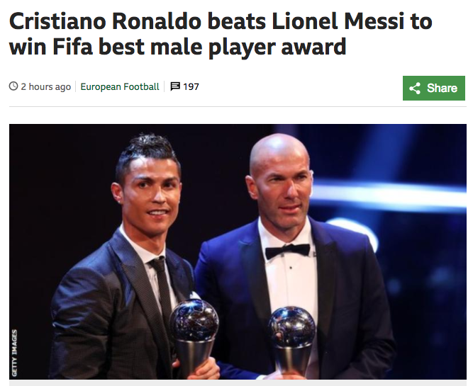
Dominance of these two players
Football Player's of the Year
2017 Cristiano Ronaldo
Source: http://www.topendsports.com/sport/soccer/list-player-of-the-year.htm
BBC sports news; on Oct 23rd, Monday

Slide 22

Look at one feature
Top4
Non-Top4
Notes:
First result here, let us briefly explore the data with one feature, of ‘goals scored per game’. Each point correspond to one team in that year. For the y axis, value of 1 means that the team is truly top4 in that year. This gif is showing the evolution of goals scored and true top 4 teams over time. What I need to do is to find the best cut, to separate out the top 4 teams.
Obviously, one feature is not sufficient, I add another feature of goals lost into the model, as shown in the y axis in this slide. Similar ideas is to isolate the top 4 team.

Slide 23
32 million EUR
37.64 million dollars
1 million per game
11,000 per minutes
Base fee for group stage: €12,700,000
https://en.wikipedia.org/wiki/UEFA_Champions_League#Prize_money

Slide 24
Ideas
Validate “Data >> Features >> Algorithm”
garbage in , garbage out

Slide 25
Average value for Top4 teams
Goals scored
Goals lost
Notes:
If we look at the features overtime, we can see that, the average goals scored is increasing after the year of 2012

Slide 26
Simulated results

